Slide 1
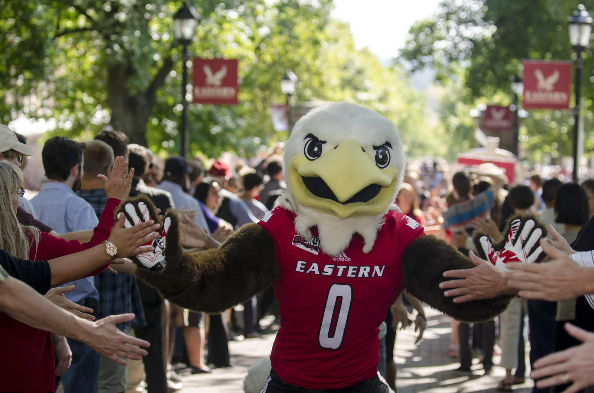
Student Affairs Budget Hearing
Presented to the University Budget Committee

Slide 2
Student Affairs Budget Presentation
Reflections
FY24- State Funding
FY24- Self Funding
Considerations
  COVID Recovery & Impact
  Higher Education Climate
  Strategic Resource Allocation
  VPSA Transition
Some Things Remain the Same
  Students often choose a school based on a feeling
  Students will often stay at a school when they feel like they belong and are connected
  Our job is to come together to meet the needs of the students and foster belonging, collectively
Notes:
NOTES
We talk about student success all the time, every day as a fundamental support mission for Student Affairs
In a national survey conducted by the National College Auxiliary Services Association students noted that the most important factors in achieving success is student community, then academic personnel and non-academic personnel. Student Affairs at EWU is foundational to developing student community (PUB, Housing, Student Activities, Campus Rec)
We’re not saying students don’t want to graduate or get good grades. What we’re saying is that when you really ask students what is important, it’s about development– This is where Student Affairs matters as a partner in education at EWU.
We know that what is ahead is a number of students that will need additional support – mental health, wellbeing and COMMUNITY connection will make ALL THE DIFFERENCE

Slide 3

Reflections
Budget Planning
Notes:
NOTES

Slide 4
FY23 Notable Reflections
Student Engagement
  Restructuring Career Services
  Development of Family Programs
  Addition of Aspire Program & Grant ($90k)
  Reduced Housing Occupancy
Student Equity, Belonging, and Voice
  Naming of the JLR Multicultural Center
  Staff Increase in JLR Multicultural Center & Pride Center
  Teaching English in Emergencies Grant ($63k)
  Fundraising Campaign for Veterans Reflective Space
Student Life
  Staff Increase – Student Accommodations & Support Services & Catalyst
  Passport Program
  Students in Recovery & Great Plays Grants ($70k)
  Adaptable Dispute Resolution
Student Affairs Challenges
  Division is predominately supported by non-state funds and enrollment has had a significant impact on funding levels. While we have maintained staffing lines, operation dollars have been significantly reduced.
  Global Services Support
  Aspire Support
Notes:
NOTES

Slide 5

FY24
State Funding

Slide 6
Student Affairs
Index 1 State & Tuition (partial funding)
Continued reliance on self support
S&A capacity limitations
Fee tolerance threshold/competitive market positioning
Fund spending alignment
Notes:
NOTES

Slide 7
Student Affairs- Index 1 (State & Tuition)
 | FY22 | FY23 | FY24 (Planned)
Personnel | 1,977,897 | 2,025,882 | 3,212,936
Operations | 315,993 | 348,141 | 239,574
TOTAL | 2,293,890 | 2,374,023 | 3,452,510
Of Note
Reduction Total FY19-FY22: $234,361 OR 10.22%
Notes:
NOTES
SIGNIFICANT REDUCTIONS OCCURRED IN FY19
Departments Primarily Supported by L1
Part of Student Rights and Responsibilities
VPSA
AVP for SEBV
AVP for Student Life
VRC
Career Services
Part of SASS
Most of JLR Multicultural Center & Pride Center

Slide 9

FY24
Self-Support
Notes:
NOTES

Slide 10
Sources of Self-Support Funding
New Student Enrollment Fee
Housing
Health Services Fee
PUB Fee
Student Disciplinary Fines
Grants & Contracts
S&A Fees
Transportation Fee
Notes:
NOTES

Slide 11
Areas On Self-Support
Departments Supported
Student Life
  Childcare (S&A)
  Student Accounting (S&A)
  Counseling & Wellness (Health Fee)
Student Engagement
  PUB Operations (PUB)
  Student Engagement & Recreation (S&A)
  New Student Transition & Parent Programs (NSE Fee)
  Housing & Residential Life
Student Equity, Belonging & Voice
  Multicultural Center (S&A)
  Pride Center (S&A)
  ASEWU (S&A)
  Easterner (S&A)
  Global Student Services (Student Fees)

Slide 12
Self-Support Funding Overview

Slide 13
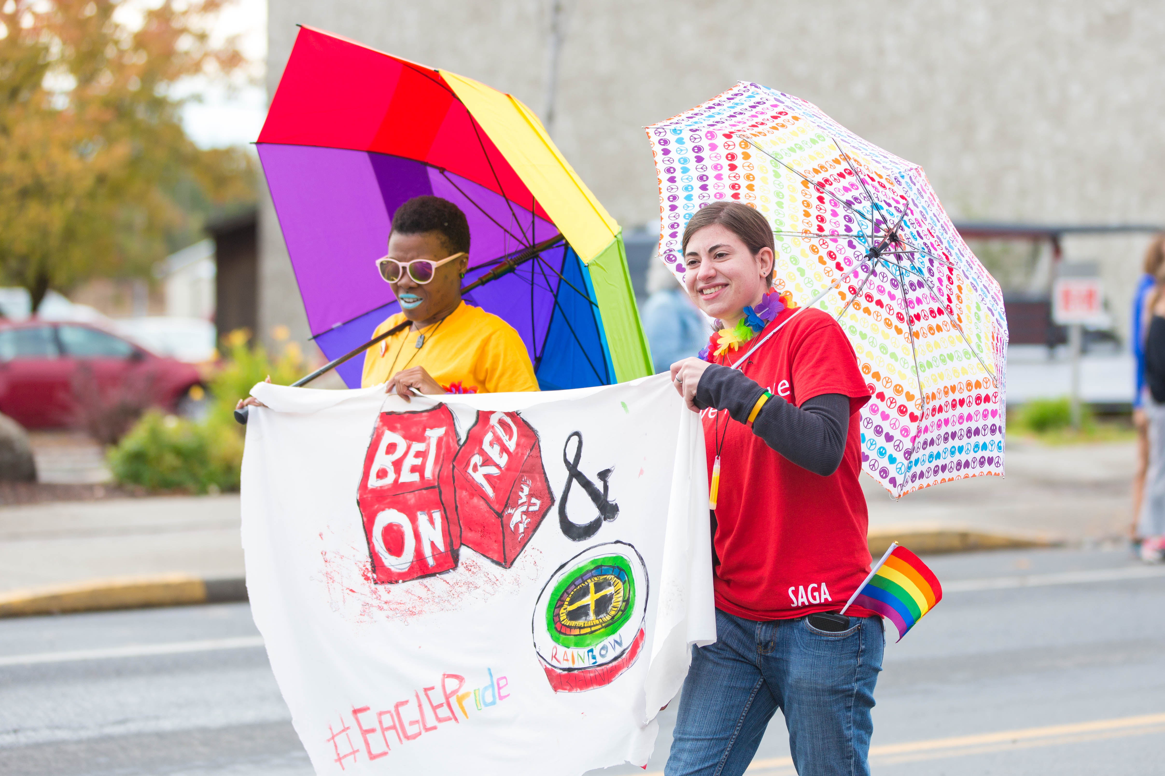
FY24
FOCUS

Slide 14
MEETING THE CHALLENGE
We Will Continue To
  Engage in budget training and education throughout the Division
  Review contracts and systems to prevent duplicate systems
  Identify external funding sources in partnership with the Foundation
We believe in helping our staff, who have the passion to meet EWU students’ needs and wants, to have the professional acumen to get it done.
Notes:
REDUCTIONS WILL BE ON S&A

Slide 15
FOCUS MOVING FORWARD
Student Life
Student Engagement
Student Equity, Belonging & Voice
Continued focus on working from a place of abundance and true partnership over silos and scarcity.

