Slide 1
Top Resources in Support of your Award
The Office of Grant & Research Development
https://inside.ewu.edu/ogrd/

Slide 2
Meet our team: Pre-Award

Slide 3
Meet our team: Post-Award

Slide 4
Working with OGRD
Pre-Award
Post-Award
Compliance
Funding Opportunities
Proposal Development
Proposal Submission
Award Setup
Award Maintenance
Award Closeout
CITI Trainings
EWU Policies
Board Attendance

Slide 5
Award Introduction
Introduction from Pre-Award to Post-Award
Award Letter
Roles & Responsibilities
Expenses
Billing & Reporting Requirements

Slide 6
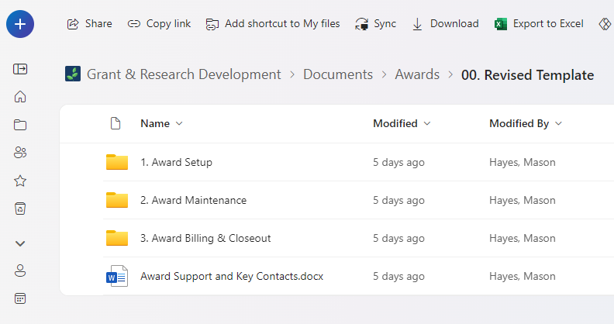
OneDrive
Shared Folder between OGRD & Program
Contains Award Information
Budget Monitoring Spreadsheet
Other Key Resources

Slide 7
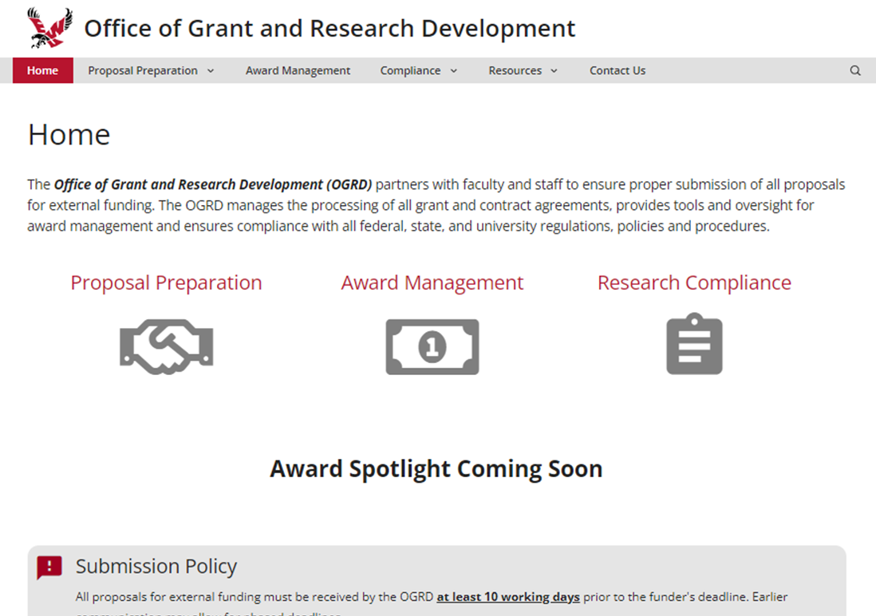
OGRD Website
https://inside.ewu.edu/ogrd/

Slide 8
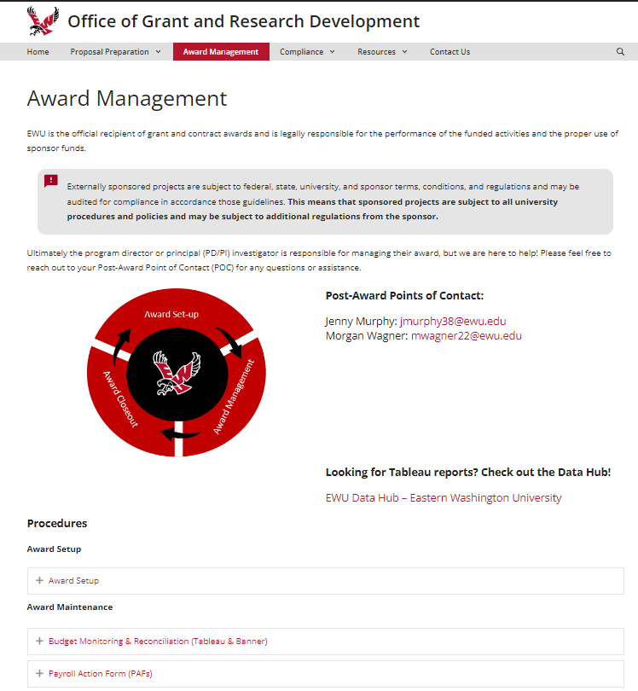
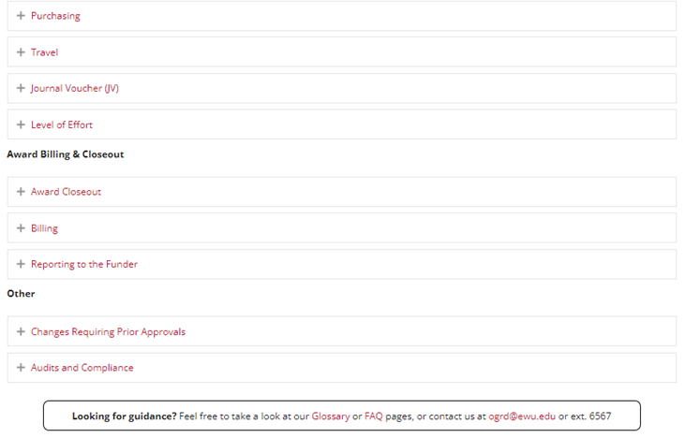
OGRD Website

Slide 9
OGRD Website

Slide 10
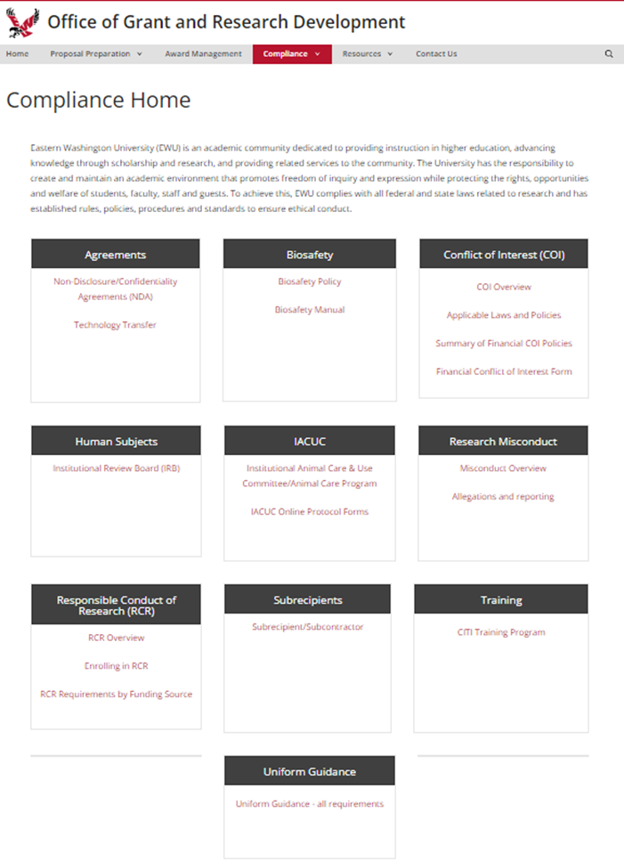
OGRD Website

Slide 11
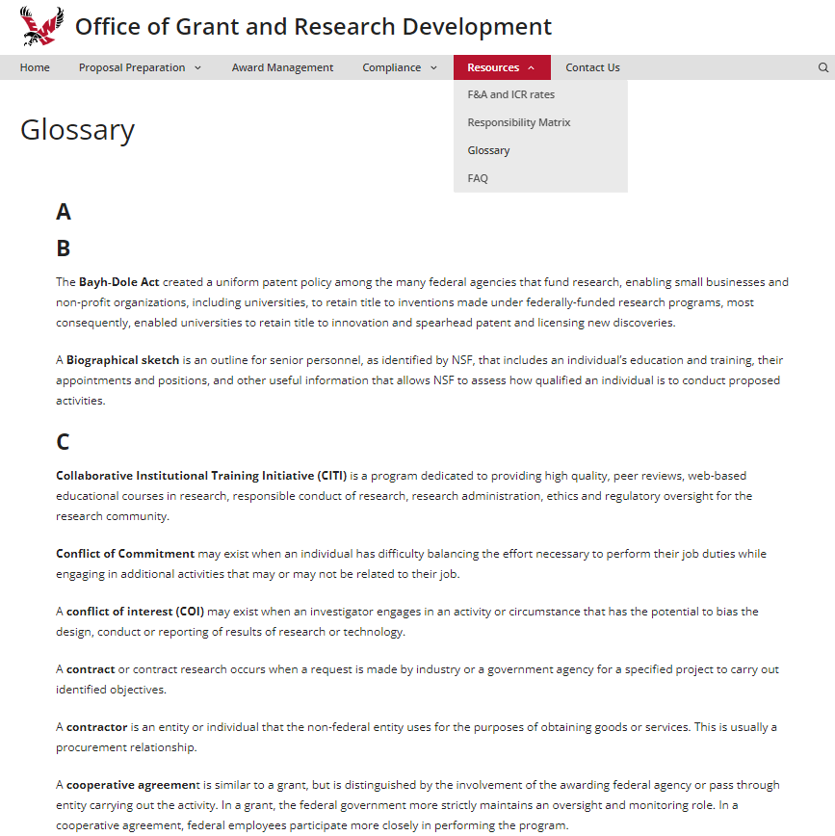
OGRD Website

Slide 12
Tableau
EWU Data Hub
OGRD Website
Award Management
Data Hub Link
Report Selection

Slide 13
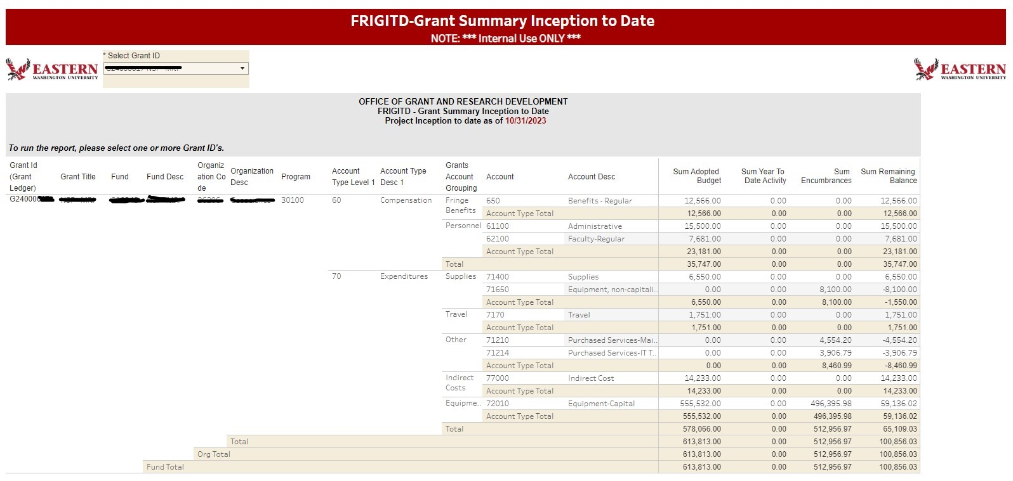

Slide 15
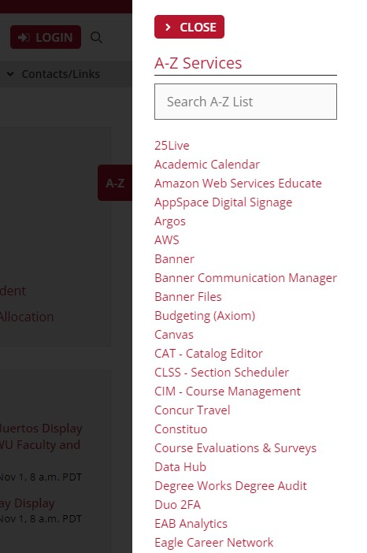
Banner

Slide 17
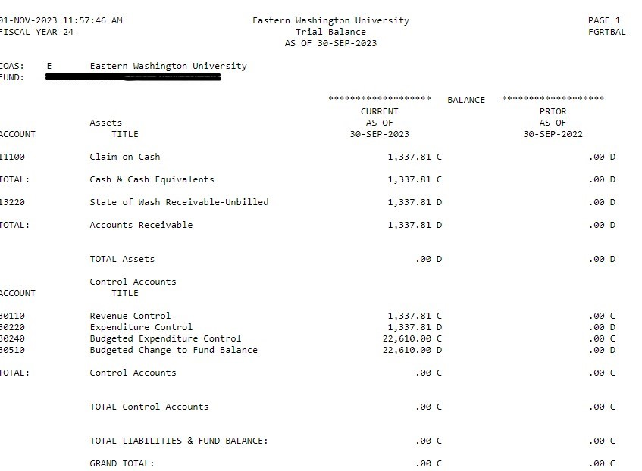

Slide 18
Monitoring

Slide 19
Items Needed
Email from OGRD confirming award
Sponsored Award Letter
Tableau and/or Banner Info

Slide 20
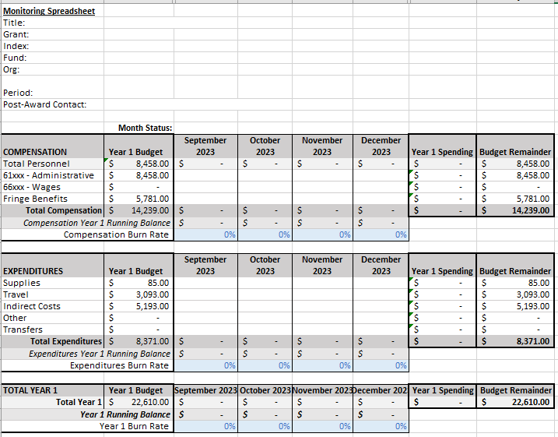
Monitoring Spreadsheet

Slide 21
Monitoring Spreadsheet In Progress

Slide 22
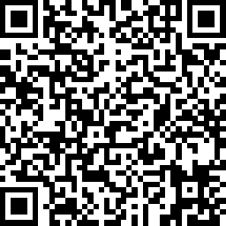
We Want to Hear From You!
https://www.surveymonkey.com/r/RNVBDKJ

