Slide 1
Strategic Resource Allocation Update
Mary Voves & Jon Anderson
SRA Co-Champions
BOT Presentation: February 23, 2023

Slide 2
What is Strategic Resource Allocation (SRA)?
SRA is a process by which we will examine the ways our resources are being invested
It addresses all institutional costs
All university services and academic programs will be reviewed equally and transparently
SRA will provide a plan to rebuild EWU’s financial health and sustainability
SRA Consultant, Larry Goldstein, hosted 4 information forums on January 17 and 18 to educate the campus community on the SRA process. A video recording of the first forum has been made available on the SRA website.

Slide 3
The Strategic Resource Allocation Process
Phase I – Organization
Establish Facilitation Team
Conduct Information Forums
Begin Cataloging Data
Begin Defining University Services and Academic Programs
Establish Task Forces
Phase II – Kickoff
Complete Task Force Training
Select and Weight Criteria
Preliminary Identification of University Services and Academic Programs
Phase III – Preparation (Current Phase)
Develop Electronic Templates, Pilot, Release for Feedback, and Conduct Training
Gather Central Data
Conduct Effort Surveys
Finalized University Services and Academic Programs
Phase IV – Data Gathering/Assessment
Phase VI – Review/Approval
Phase VII – Implementation
Phase VIII – Evaluation

Slide 4
The Strategic Resource Allocation Process
1/17-18: | Information forums
1/18: | Distribute nomination forms
1/19: | Facilitation Team meeting - Program list methodology and update - Discuss catalog of data - Review templates - Discuss effort surveys
1/25: | Nomination deadline
1/26: | FacTeam meeting - First review of program list
1/26: | FacTeam meeting - assign 2 members to work on each effort survey, assuming 3 surveys
1/26: | FacTeam meeting - assign subteam for template (shell) development
1/27: | Mary/Jon meet with union leadership for nomination input
1/30: | ELT first review of nominations
2/2: | ELT second review of nominations - confirm selections
2/2: | Notify task force members of selection
2/2: | FacTeam meeting - discuss data set methodology
2/2: | FacTeam meeting - Programs defined
2/2: | Facilitation Team meeting - review indirect costs
2/6: | Campus msg from Jon/Mary re TF selections, promote town hall attendance
2/9: | Facilitation Team meeting - review catalog of data
2/9: | Facilitation Team meeting - Review effort surveys, agreement
2/9: | SRA Town Hall Session (virtual)
2/14: | Academic Program Task Force Training
2/15: | University Services Task Force Training
2:16: | Combined Task Force Training
2/16: | FacTeam attends TF Trng - review program list
2/16: | FacTeam attends TF Trng - review catalog of data
2/16: | FacTeam attends TF Trng - recommends template
2/16: | FacTeam attends TF Trng - Communications Team provides TFs with overview of what has happened so far and what is scheduled for the future.
2/16: | TF Trng - discuss FoIA implications and TF documentation of work. Deborah and Annika on hand to answer questions.
2/20: | Progam list distributed to community for feedback
2/23: | FacTeam meeting - approve indirect cost allocation methodology
2/23: | Facilitation subteams update templates as necessary, provides to TF for testing
2/23: | FacTeam - ongoing data set work
2/24: | Community feedback re program list due
3/2: | Task forces & Facilitation Team finalize program/function list
3/2: | TFs test templates (big, small, anomoly)
3/2: | FacTeam - ongoing data set work
3/3: | SRA Town Hall Session (SHW109)
3/6: | Distribute effort surveys
3/9: | FacTeam - ongoing data set work
3/9: | Distribute templates to campus for feedback
3/15: | Completed effort surveys due
3/16: | FacTeam - ongoing data set work
3/16: | Templates - campus feedback due
3/23: | FTeam meeting - Data sets reviewed and finalized
3/24: | SRA Town Hall Session (virtual)
3/30: | Facilitation Team finalizes templates
4/11: | SRA Town Hall Session (in-person)
4/15: | Templates published electronically
4/25: | SRA Town Hall Session (virtual)
5/12: | SRA Town Hall Session (SHW109)
6/1: | Department templates completed and returned
6/1: | SRA Town Hall Session (virtual)

Slide 5
SRA Facilitation Team Update
Jackie Coomes & Toni Habegger
SRA Facilitation Team Co-Chairs

Slide 6
Facilitation Team Members
Co-Chair | Representing
Jackie Coomes | Vice Provost for Academic Affairs
Toni Habegger | CFO and AVP for Financial Services
Team Member | Representing
Sam Armstrong Ash | Dean of Students / VP of Student Life
Mark Baldwin | President's Chief of Staff
Brad Christ | AVP for Information Technology
Deborah Danner | AVP for Human Resources
Tessa Delbridge (Communications) | EWU Relations Strategist
Admir Djulovic | Mgr of Data Analytics for Financial Svcs
Shawn King | AVP for Facilities and Planning
Lance Kissler (Communications) | AVP for University Relations
Jake Morrison | Exec. Dir. for Institutional Research
Heather Veeder | AVP for Student Success, Planning & Policy

Slide 7
Facilitation Team Role
Provides logistical support to the co-champions and task forces.
Scope of responsibilities include:
Defining the program list,
Defining the data sets,
Allocating indirect costs,
Distributing effort surveys, and
Distributing the templates.
The communications representatives assist with the sharing of information throughout the process.

Slide 8
Facilitation Team Action Items
Phase I – Organization
Establish Facilitation Team
Catalog Data
Define University Services and Academic Programs
Phase II – Kickoff
Develop effort surveys and template shell
Preliminary Identification of University Services and Academic Programs
Determine allocation of indirect costs
Phase III – Preparation (Current Phase)
Develop Electronic Templates, Pilot, Release for Feedback, and Conduct Training
Gather Central Data
Conduct Effort Surveys
Finalized University Services and Academic Programs
Phase IV – Data Gathering/Assessment
Phase VI – Review/Approval
Phase VII – Implementation
Phase VIII – Evaluation

Slide 9
SRA Task Force Updates
Tony Masiello, Academic Program Task Force Chair
Nina De Camp, University Services Task Force Chair

Slide 10
Academic Programs Task Force Members
Team Member | Representing
Mindy Breen | CSTEM - Design
Lesli Cleveland | CHSPH - Communication Sciences & Disorders
Kate Crane | CAHSS - English
Kevin Decker | CAHSS - Philosophy
Tara Haskins | CPP - School of Education
Heidi Hillman | CPP - School of Psychology
German Izon | CAHSS - Economics
Kara Lopez | CPP - School of Social Work
Anthony Masiello (Chair) | CSTEM - Chemistry, Biochemistry & Physics
Camille McNeely | CSTEM - Biology
Richard Orndorff | CSTEM - Geosciences
Esteban Rodriguez-Marek | CSTEM - Computer Science & Electrical Engineering
Julia Smith | CAHSS - HAMLL
Katie Taylor | CHSPH - Wellness & Movement Sciences
Deanna Trella | CPP - Social Work
Chris Tyllia | CAHSS - Fine and Performing Arts

Slide 11
University Services Task Force Members
Team Member | Representing
Scott Buck | Facilities Services
Natalie Cifuentes | Center for Academic Advising and Retention
Emilie Crawford | Nursing
Nina De Camp (Chair) | Public Records
Kristina Guilfoyle (Faculty) | Faculty - AUAP
Dr. Chadron Hazelbaker (Faculty) | Faculty - Wellness and Movement Sciences
Augie Hernandez | WFSE - Sports Equipment Manager 2
Dr. Terrance MacMullan (Faculty) | Faculty - Philosophy
Dr. Michael Ochi | PSE - Counseling and Wellness Services
Rocio Rangel | Exempt - CAMP
Maria Reyna | Exempt - New Student Family Programs
Tracey Rice | Library Archives
Michelle Schultz | Exempt - Student Facilities / Housing
Sarah Strong | PSE - CSTEM Undergrad/Grad Services Admin
Maria Szep | WFSE - Psychology
Mark Ward | WFSE - Records and Registration

Slide 12
Task Force Action Items
Phase I – Organization
Establish Task Forces
Phase II – Kickoff
Complete Task Force Training
Select and Weight Criteria
Preliminary Identification of University Services and Academic Programs
Phase III – Preparation (Current Phase)
Task Forces Determine Meeting/Work Schedule
Test Templates
Develop Electronic Templates, Pilot, Release for Feedback, and Conduct Training
Finalized University Services and Academic Programs
Coordinate with Facilitation Team to Distribute Templates
Phase IV – Data Gathering/Assessment
Phase VI – Review/Approval
Phase VII – Implementation
Phase VIII – Evaluation

Slide 13
SRA Communications & Timeline Update
Lance Kissler & Tessa Delbridge
SRA Facilitation Team - Communications

Slide 14
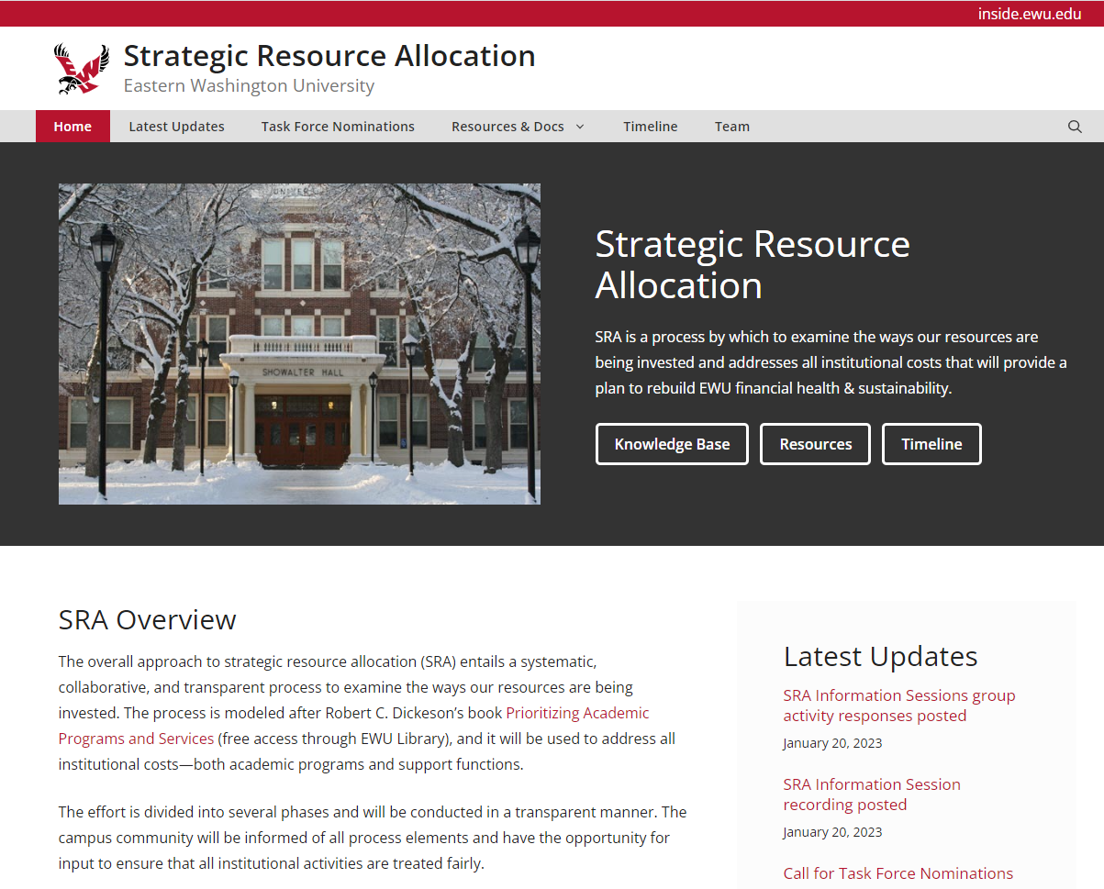
Website
Updated regularly
Process transparency
Anonymous question/comment submission
Library of resources
Comprehensive, searchable knowledge base

Slide 15
Communications Plan and Timeline
January 2023
Jan. 9: Campus Email Invitation to Information Sessions sent from Co-Champions Mary and Jon via SRA inbox; RSVP’s managed by President’s Office
Jan. 9: Faculty Senate meeting - response to questions posed by FS
Jan. 10-11: Update SRA website with Facilitation Team roster & Larry Goldstein info
Jan. 11: Soft Launch of Knowledge Base on SRA website
Jan. 12: Email Reminder for Info Session Registration
Jan. 17-18: SRA Information Sessions
Jan. 17: Turn on “post” features for the SRA website (Latest Updates)
Jan. 18: President’s Eagle 1 references SRA process for external and internal audiences
Jan. 19 AM: Info Session slides added to website
Jan. 19 AM: Nomination information sent via email from SRA inbox co-signed by champions; website update to include nomination submission web form; KB announced and updated
Jan 20 AM: Info session video recording added to website
Jan. 19 Info sessions flipchart photos added to website
Jan. 19: InsideEWU story “SRA Process Starts with Well-Attended Listening Sessions”
Jan. 23: Senate Report includes stand-alone SRA update from co-champions
Jan. 23: InsideEWU Announcement - Nomination reminder
Jan. 24: Update KB based upon Faculty Senate feedback
Jan. 24: Update web/email form with anonymous option
Jan. 25: Nomination form closes; website updated
Jan. 25: ELT Newsletter out with SRA update

Slide 16
Communications Plan and Timeline
February 2023
Feb. 3: Acceptance letters sent to nominees for task force (Members appointed by ELT)
Feb. 3: Town Hall schedule published to SRA website and added to “latest updates”
Feb. 6: Town Hall Announcement - Included in InsideEWU Tuesday email blast
Feb. 7: Op-Ed from President in Spokesman-Review
Feb. 8: Thank you letters sent to nominees not chosen
Feb. 9: Website update with Task Force selections
Feb. 9: Feature Story submission on InsideEWU announcing task force members
Feb. 9: Town Hall #1 - Virtual
Feb. 13: Senate Report includes SRA update
Feb. 16: Communication Plan presented to Task Forces
Feb. 22: Executive Leadership Update Newsletter out with SRA update from President
Feb. 23: SRA Update at Board of Trustees meeting
March 2023
Mar. 3: Town Hall #2 - In-person
Mar. 13: Senate Report includes SRA update
Mar. 24: Town Hall #3 - Virtual
Mar. 29: Executive Leadership Update Newsletter out with SRA update
TBD: Distribution of effort surveys & InsideEWU announcement
TBD: Templates posted on website for feedback
TBD: Distribution of templates & InsideEWU announcement

Slide 17
Questions? Thank you and go EAGS!

