Slide 1
EagleNet Time Entry
All timesheets are accessed through EagleNet
Sign into EAGLENET with your SSO log on
Go to EMPLOYEE, select TIMESHEET
After verifying the correct pay period select START TIMESHEET (once Timesheet has been started it will be IN PROGRESS)

Slide 2
EagleNet Time Entry
Once you have started the Timesheet you will be directed to the calendar.
Select the day you want to add hours to and it will be highlighted.
Select +Add Earn Code

Slide 3
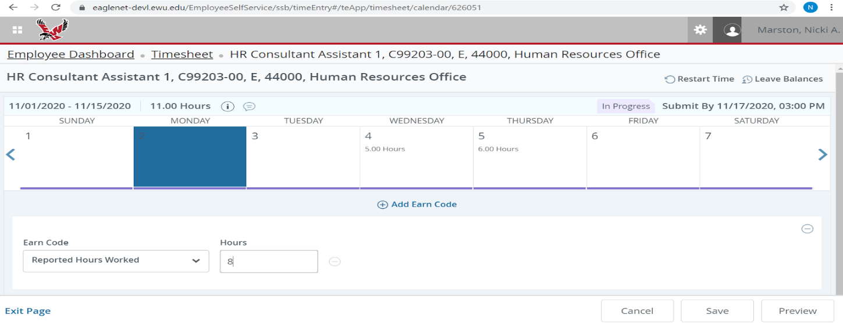
EagleNet Time Entry
Select the Earn Code from the drop-down menu.
After selecting the Earn Code, enter number of hours reporting in the Hours Tab.
Once the Earn Code and Hours have been entered select the SAVE tab at the bottom of the page. (note: you can enter in more than one earn code, if necessary)

Slide 4
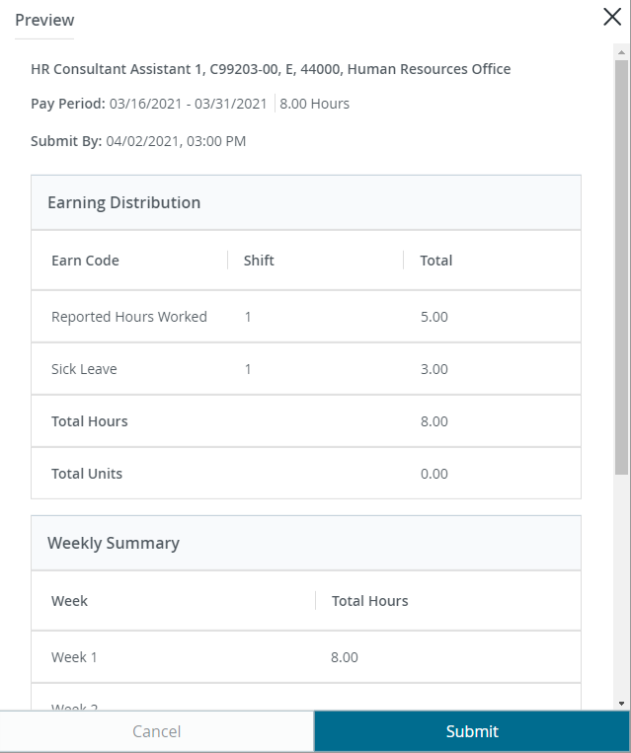
EagleNet Time Entry
Once all time has been entered for the pay period select the Preview Tab at the lower right corner
Select the Submit Tab for submission of all time for that time period

